Slide 1
COMfortel Mobile Business
PBX Manager

Slide 2
COMfortel Mobile Business

Slide 3
COMfortel Mobile Business
Signal the business phone number
One phone number – from wherever you are
Smartphone and ICT system contacts
Flexibility – the customer decides about availability

Slide 4
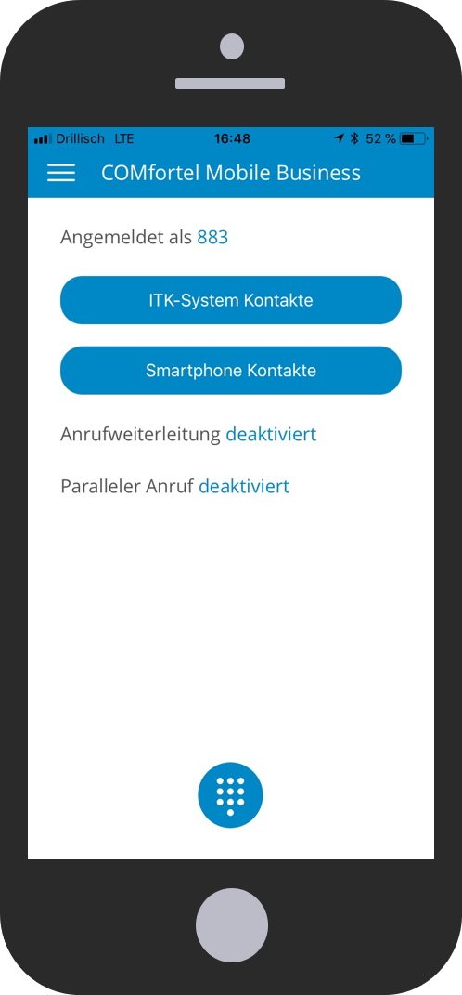
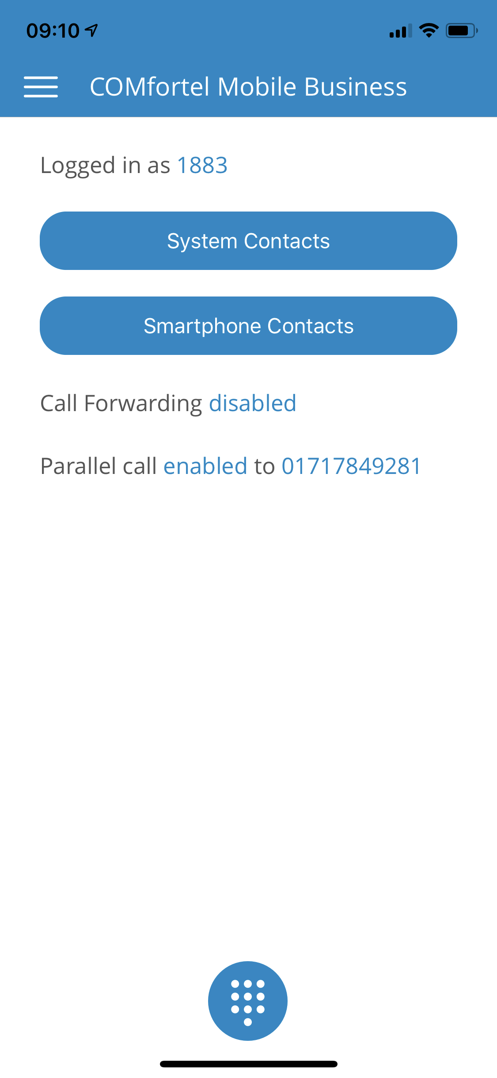
COMfortel Mobile Business
Flat UI design
Reduced to the most important features

Slide 5
Smartphone integration

Slide 6
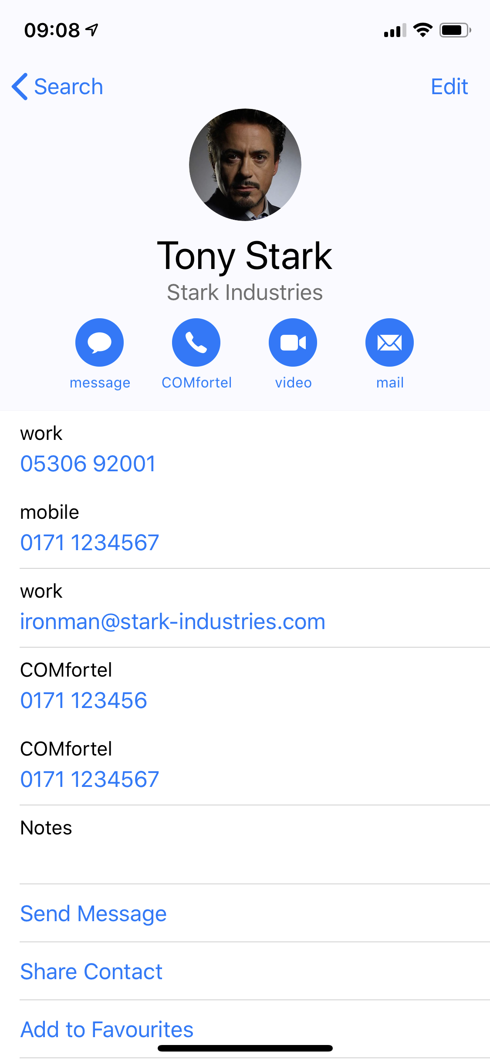
Contact integration
COMfortel Mobile Business
Business telephony using standard Apple contacts
Seamless integration in the smartphone

Slide 7
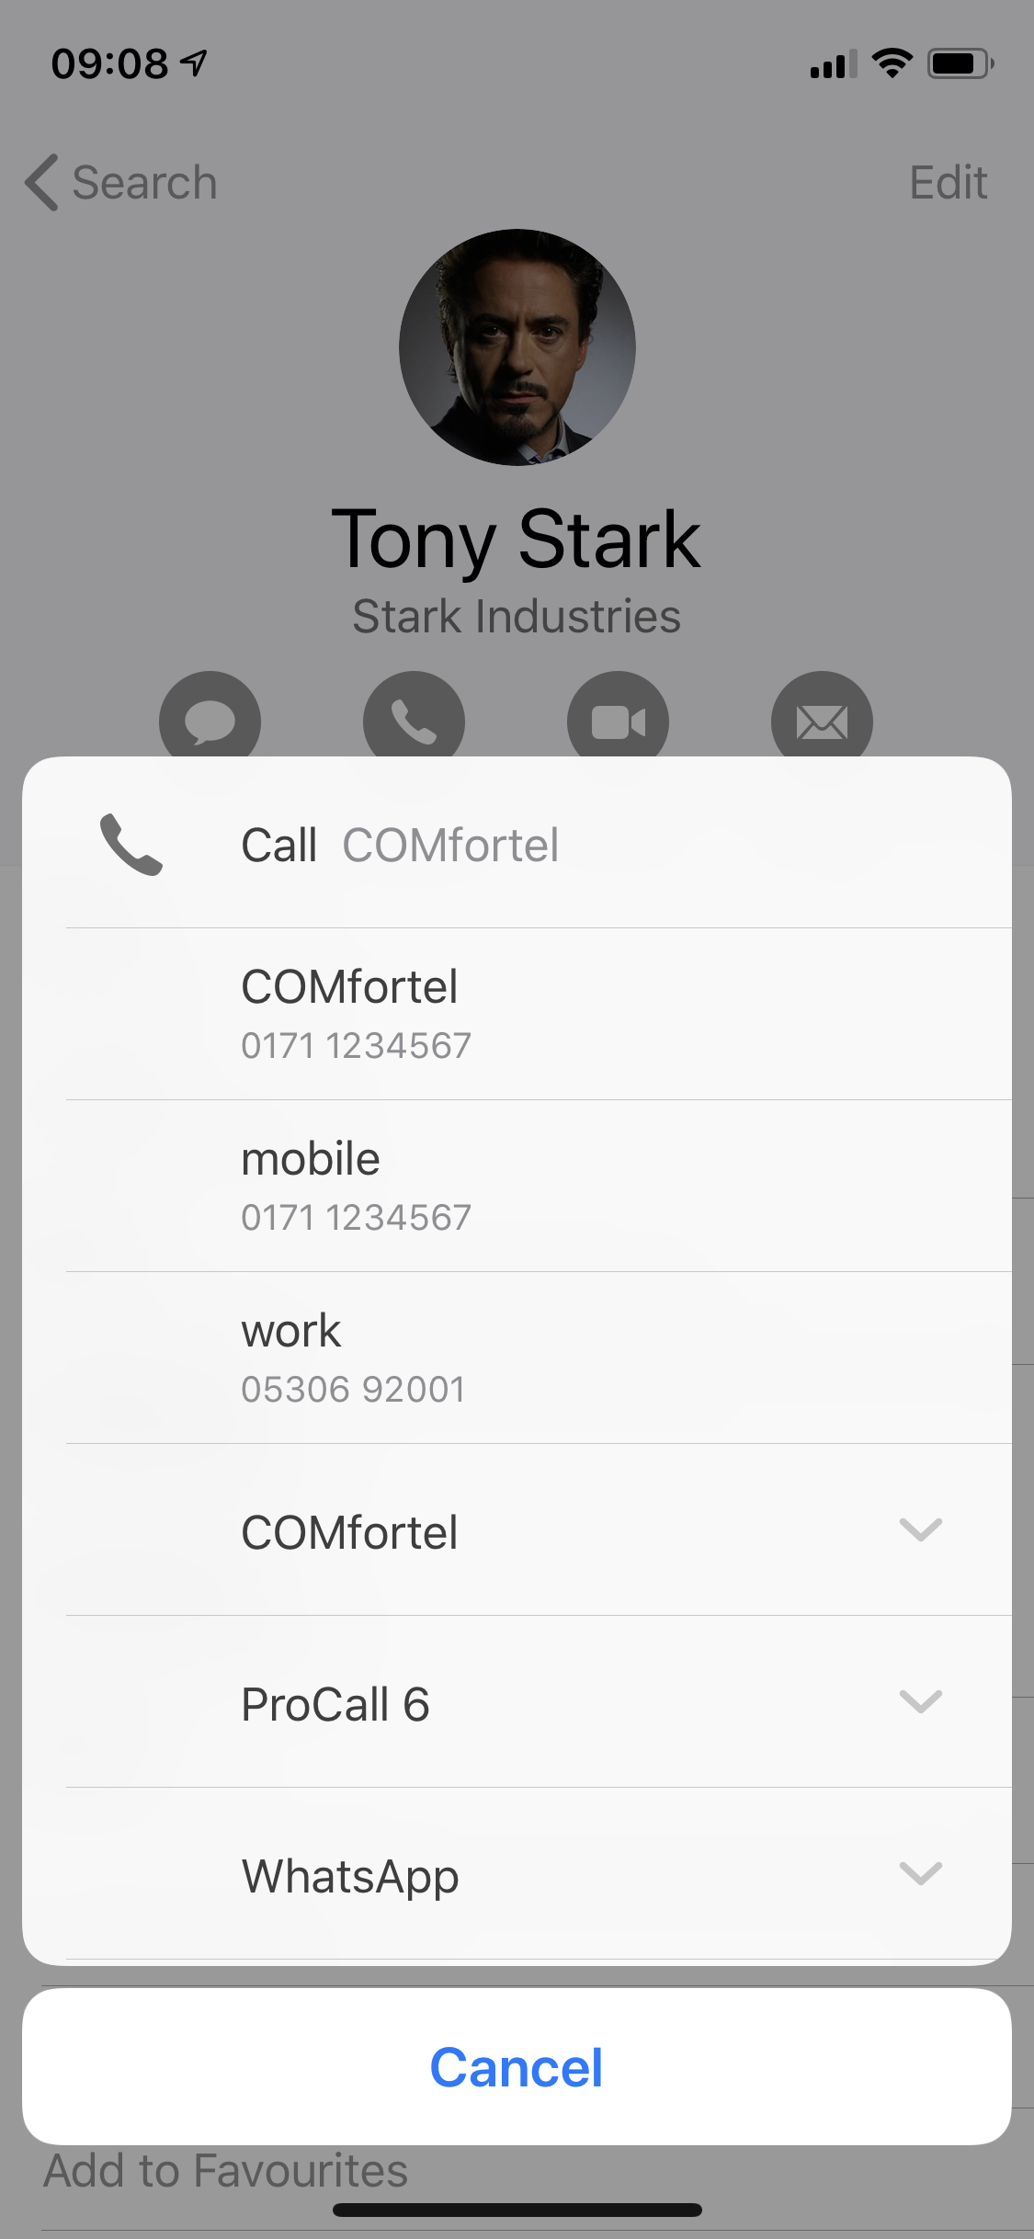
Contact integration
COMfortel Mobile Business
Business telephony using standard Apple contacts
Seamless integration in the smartphone

Slide 8
Apple Siri integration
COMfortel Mobile Business
Integration of Apple‘s voice assistant, Siri
Voice controlled business telephony

Slide 9
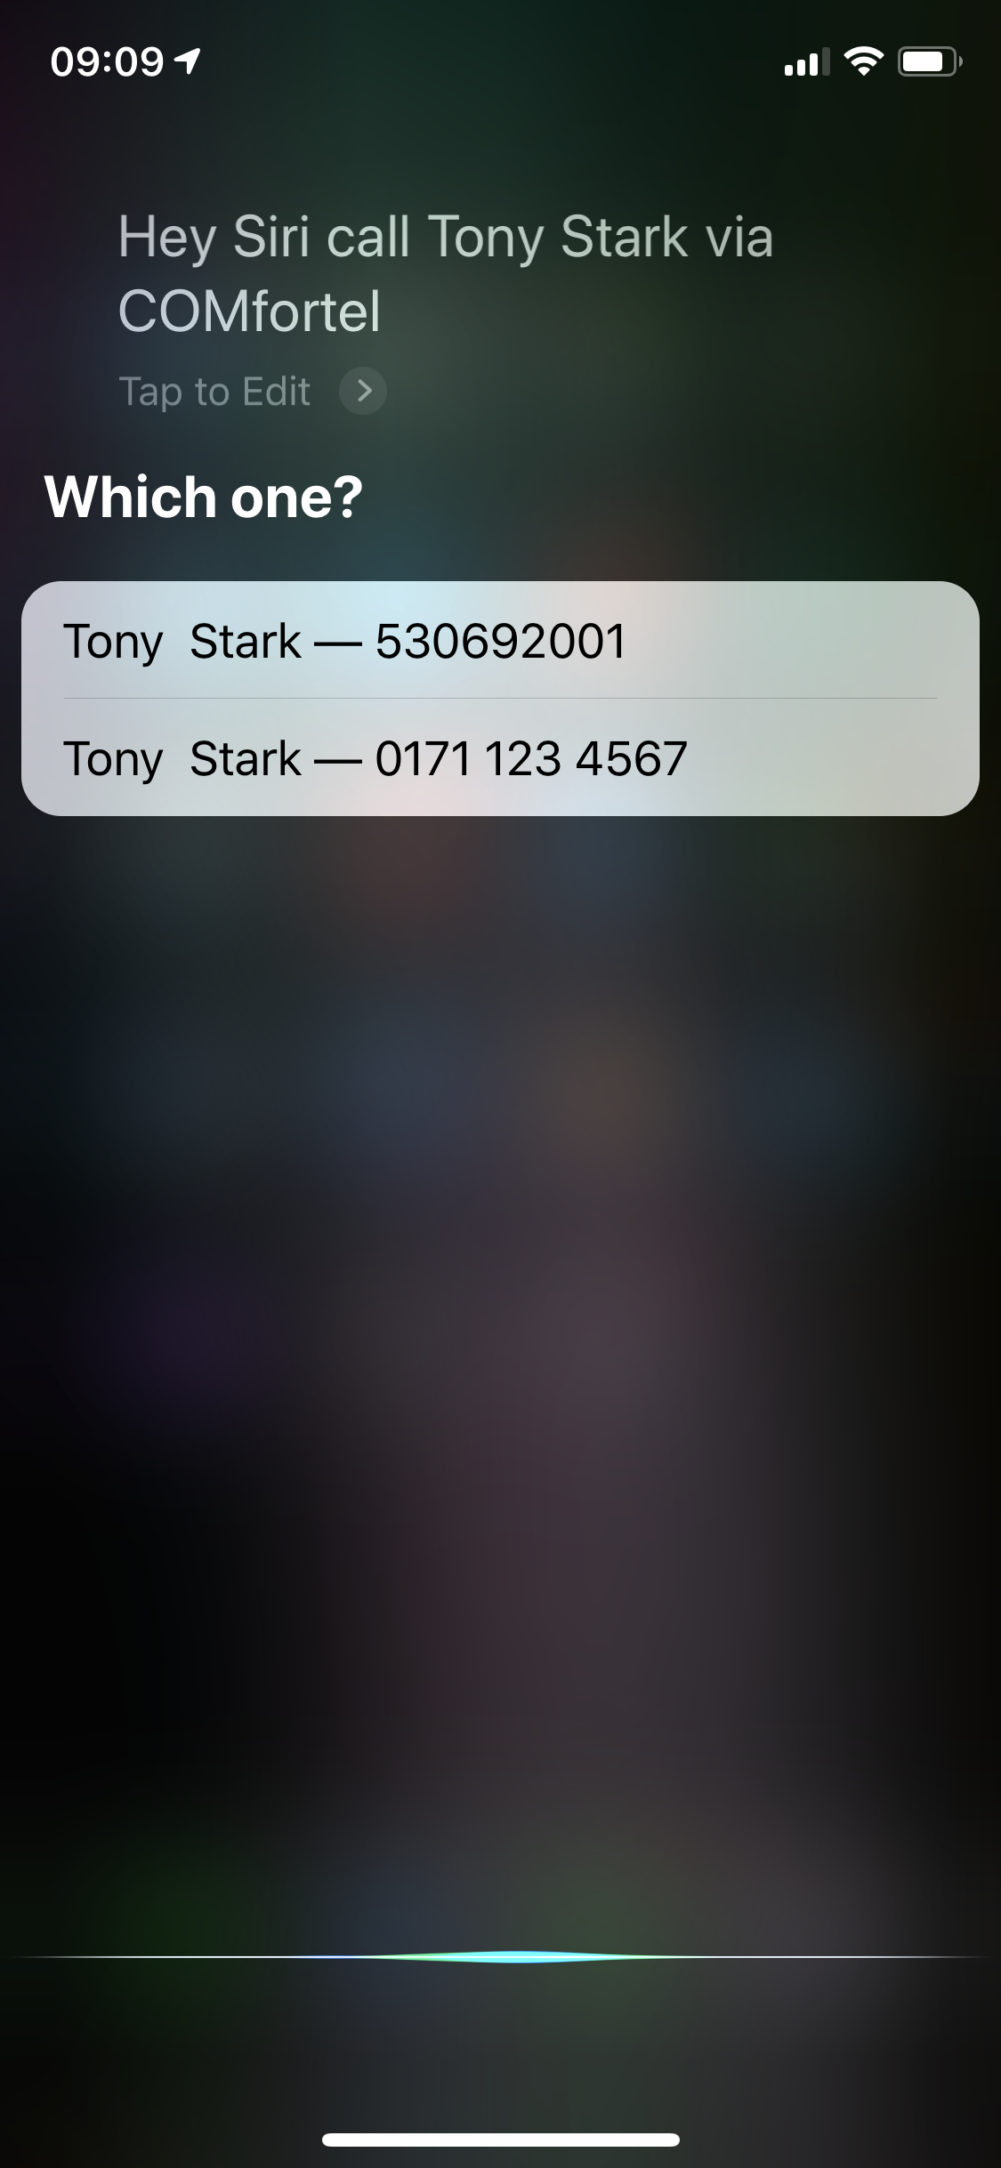
Apple Siri integration
COMfortel Mobile Business
Integration of Apple‘s voice assistant, Siri
Voice controlled business telephony

Slide 10
PBX Manager

Slide 11
PBX Manager
… will replace PBX Control
Configure and switch ICT system functions from your smartphone
Two platforms – one functional scope
New and modern UI

Slide 12
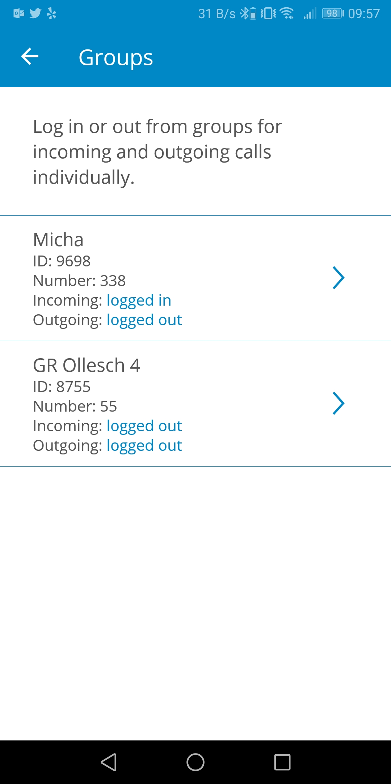
PBX Manager
Flat UI design
Improved user experience

Slide 13
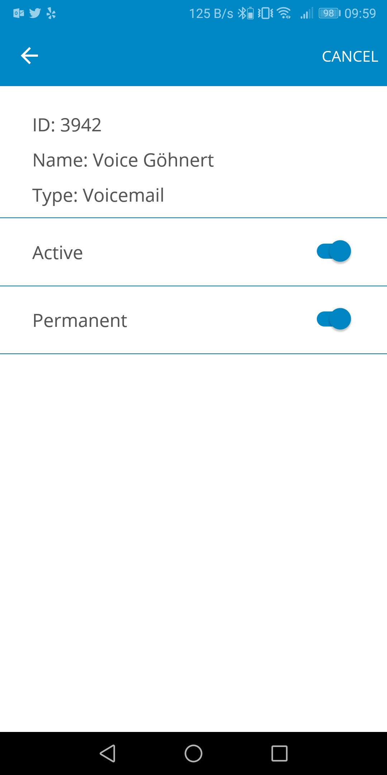
PBX Manager
Flat UI design
Improved user experience

Slide 14
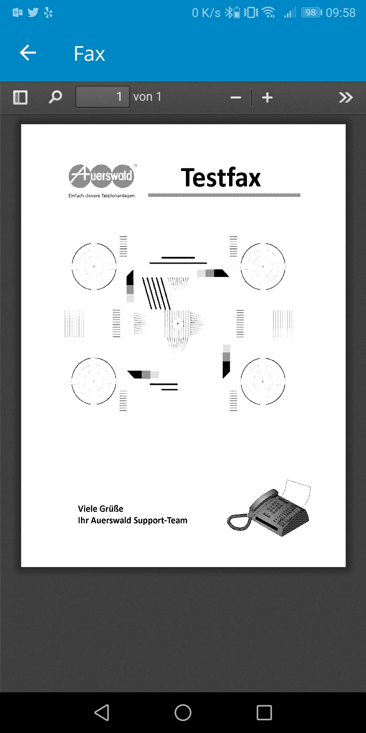
PBX Manager
Flat UI design
Improved user experience

Slide 15
Feature Set
PBX Manager
Multi Accounting
VMF swichting
Caller list
Set call forwarding
Set Call waiting
Config your groups settings
Configuration switchover

Slide 16
Thank you

