Slide 1
PBX Call Assist 3

Slide 2
Windows Client

Slide 3
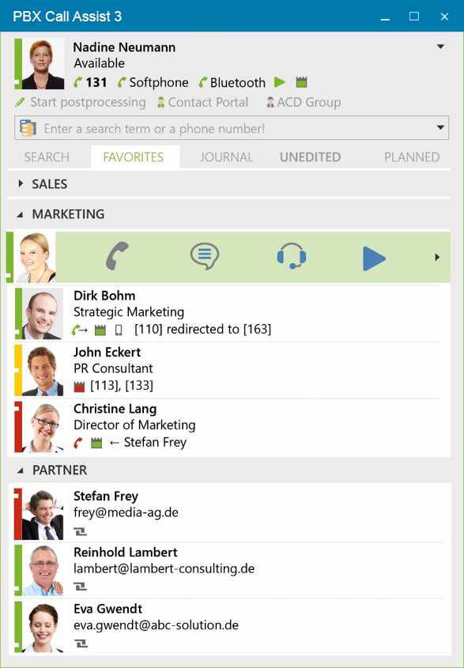

Connection – CTI, SIP and Bluetooth
131
CTI Line
Softphone
Softphone (SIP)
Bluetooth
CTI for Smartphones

Slide 4
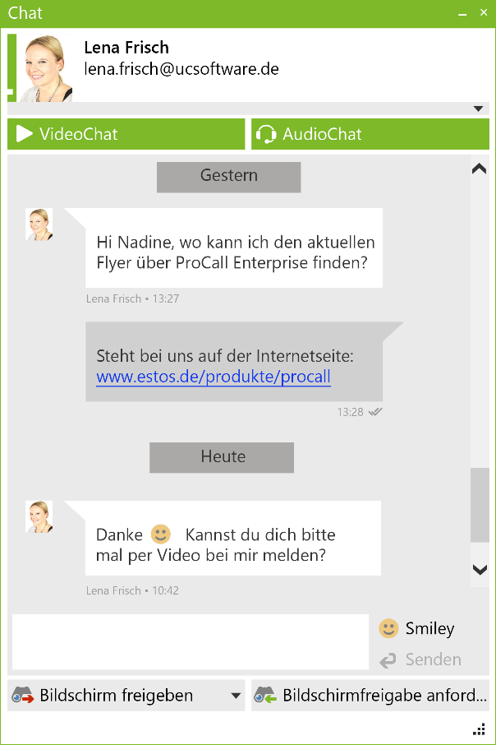

Chat
13:28

Slide 5
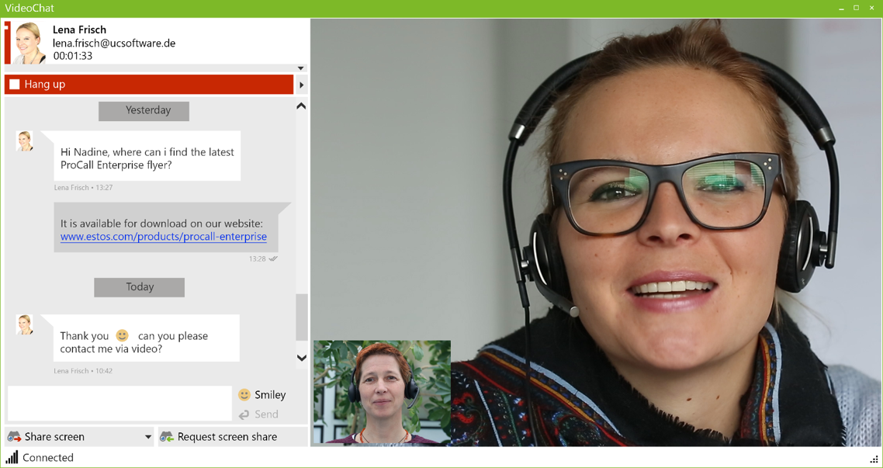
VideoChat

Slide 6
Screen Sharing

Slide 7
Other important new features
Active Directory Support
Computer Smartphone Integration (CSPI)
    Control
    Telephony via Bluetooth
Central update of the software

Slide 8
Smartphone Apps & Mac Client

Slide 9
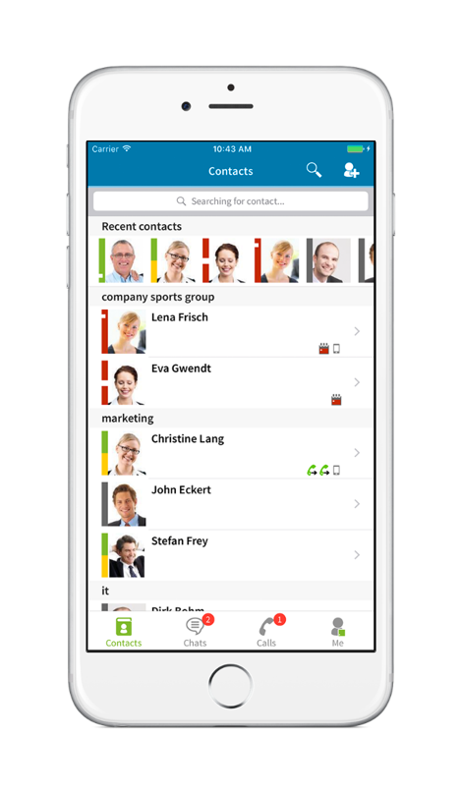
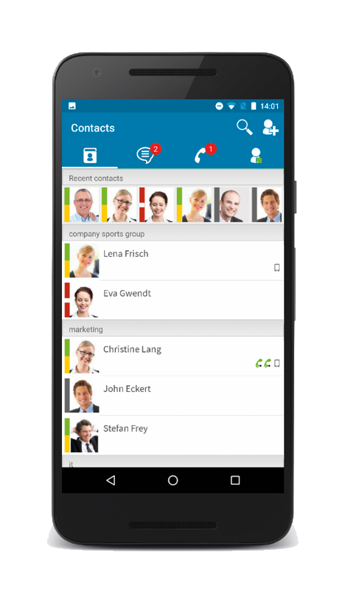

Smartphone Apps
SIP softphone and CTI funtions​
Synchronized phone journal​
Search, name resolution and contact details e.g. from CRM/ERP or industry software​
Instant messaging and presence management, incl. federation​
Audio/video chat on WebRTC Basis​
Easy commissioning with ProCall Mobility Services (optional)

Slide 10
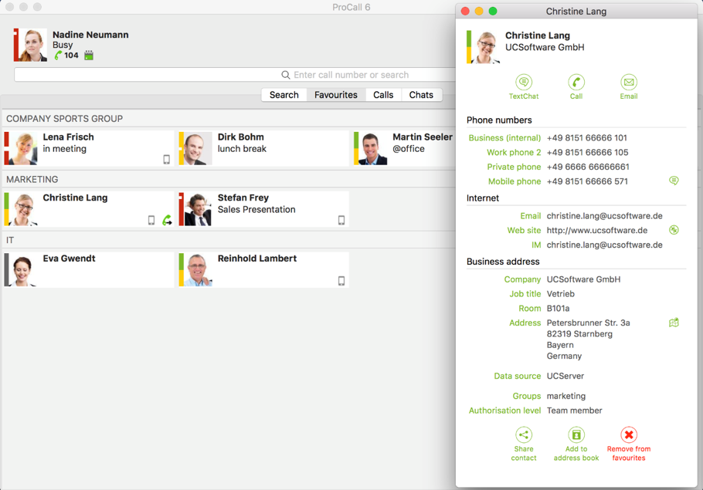
Mac Client
Computer Telephony Integration ( CTI )​
Instant messaging and presence management, incl. federation​
Integration of common CRM, ERP and industry software. Relevant information is immediately available for up-to-date contact data​
Search, name resolution for CTI calls and contact details, e.g. from CRM/ERP or groupware​
New UI in modern design and with improved usability​
Easy commissioning with ProCall Mobility Services (optional)

Slide 11
Thank you!

